Slide 1
Fair use notice
The material used in this presentation i.e., pictures/graphs/text, etc. is solely intended for educational/teaching purpose, offered free of cost to the students for use under special circumstances of Online Education due to COVID-19 Lockdown situation and may include copyrighted material - the use of which may not have been specifically authorized by Copyright Owners. It’s application constitutes Fair Use of any such copyrighted material as provided in globally accepted law of many countries. The contents of presentations are intended only for the attendees of the class being conducted by the presenter.

Slide 2
OBJECT ORIENTED PROGRAMMING
Presented by: Engr. Mariam Memon

Slide 3

Table of contents
Class and Object
A Simple Class
Creating an Object
Creating Functions in a Class
Constructors
this Keyword
Garbage Collection
The finalize() method
Method Overloading
Constructor Overloading
Encapsulation and Access Specifiers
static Keyword
static block
Introducing Math class
final keyword
Nested and Inner Classes

Slide 4
class & object
A class is a template for an object.
A class is a blueprint.
An object is an instance of a class.
Objects in a program can represent real world things or abstractions e.g. automobiles, houses and employees.

Slide 5
Class & object
There are just two kinds of things that you can include in a class definition:
Fields: These are variables that store data items that typically differentiate one object of the class from another. They are also referred to as data members of a class.
Methods: These define the operations you can perform for the class — so they determine what you can do to, or with, objects of the class. Methods typically operate on the fields — the data members of the class.

Slide 6
Class & Object
The data, or variables, defined within a class are called instance variables.
The code is contained within methods.
Collectively, the methods and variables defined within a class are called members of the class.

Slide 7
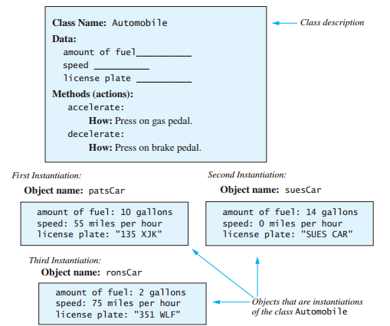
Class & objects

Slide 8
Class & Objects
Syntax
class classname {
type instance-variable1;
type instance-variable2;
type instance-variableN;
type methodname1(parameter-list) {
// body of method
}
// ...
type methodnameN(parameter-list) {
// body of method
}
}

Slide 9
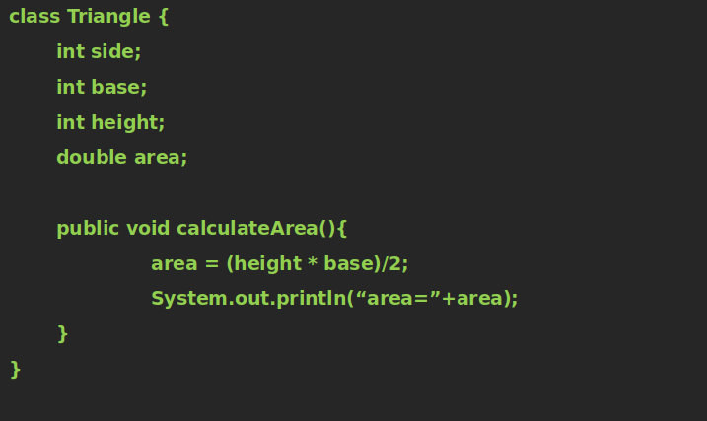
A simple class

Slide 10
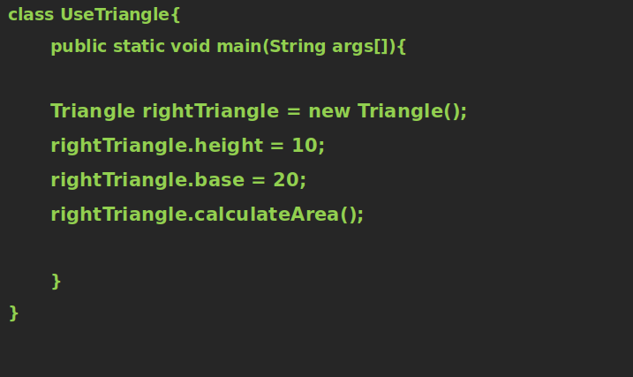
A simple class - using triangle class

Slide 11
Creating an object
Declare a variable of the class type.
The new operator provides the physical copy of the object to the variable.
The new operator dynamically allocates (that is, allocates at run time) memory for an object and returns a reference to it.

Slide 12
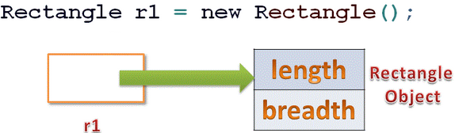
Creating an object

Slide 13
Creating functions in a class
Syntax
type name(parameter-list) {
// body of method
}
Methods that have a return type other than void return a value to the calling routine using the following form of the return statement:
return value;

Slide 14
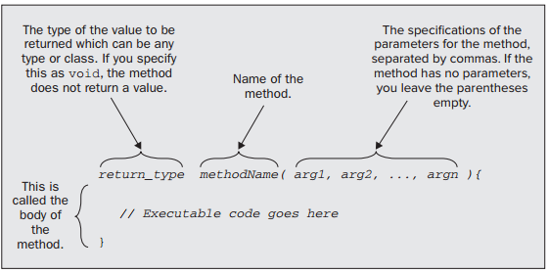
Creating functions in a class

Slide 15
Creating functions in a class
A parameter has a name and a type and appears in the parameter list in the definition of a method.
An argument is a value that is passed to a method when it is executed, and the value of the argument is referenced by the parameter name during execution of the method.

Slide 16
Example code
class FunctionDemoClass{
int a;
void function1(){
a=10;
System.out.println(“a = ”+a);
}
void function2(int x){
a=x;
System.out.println(“a = ”+a);
}
int function3(){
a=60;
return a;
}
int function4(int x){
return x;
}
}

Slide 17
Calling functions of a class
class UseFunctionDemo{
public static void main(String args[]){
FunctionDemoClass obj = new FunctionDemoClass();
obj.function1();
obj.function2(33);
System.out.println(obj.function3());
System.out.println(obj.function4(55));
}
}

Slide 18
Constructors
When an object of class is created, the constructor of that class is called.
If you don't define any constructors for your class, the compiler supplies a default constructor in the class, which does nothing.
A constructor is called once in a lifetime of an object
A constructor has two special characteristics that differentiate it from other class methods:
A constructor never returns a value, and you must not specify a return type — not even of type void.
A constructor always has the same name as the class

Slide 19
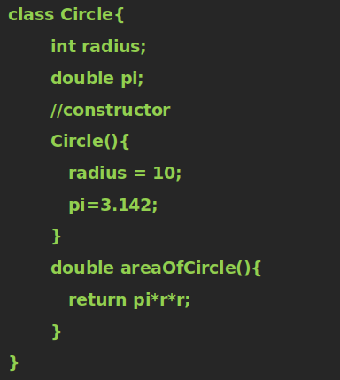
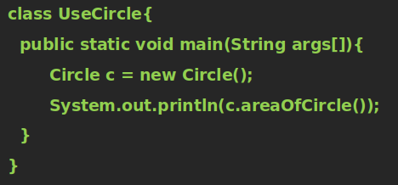
Constructors – Example code

Slide 20
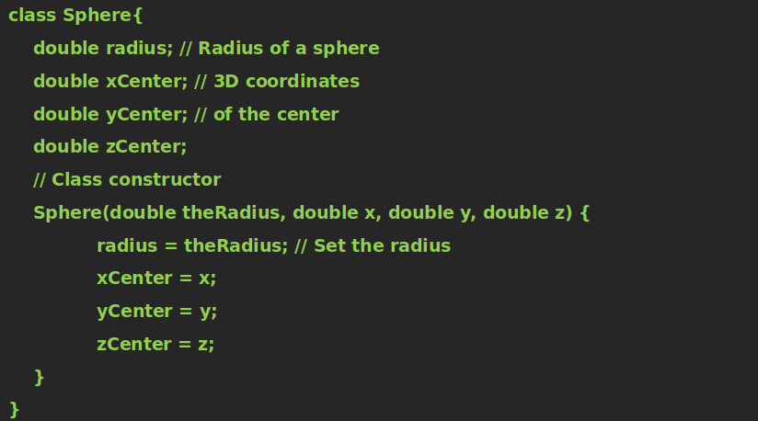
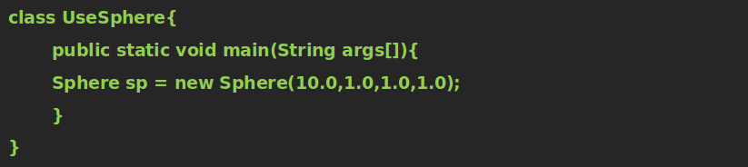
Parameterized Constructors -Example code

Slide 21
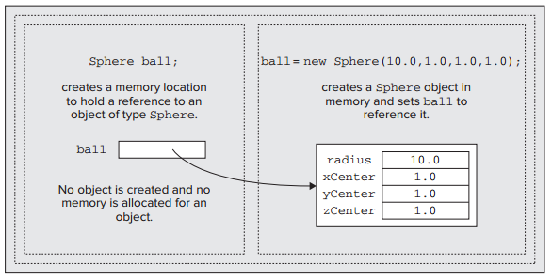
Constructors

Slide 22
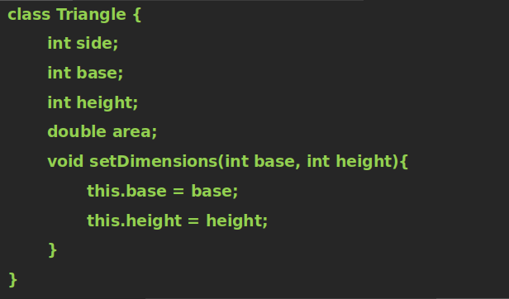
This keyword
The name this refers to the current object for which the method is being called.
The compiler uses this implicitly when your method refers to an instance variable of the class

Slide 23
Garbage collection
Java provides automatic deallocation of objects.
When no references to an object exist, that object is assumed to be no longer needed, and the memory occupied by the object can be reclaimed.
System.gc() function is called to invoke garbage collection explicitly.

Slide 24
The Finalize() Method
Java provides a mechanism called finalization that is, you can define specific actions that will occur when an object is just about to be reclaimed by the garbage collector
Syntax:
protected void finalize( ){
// finalization code here
}

Slide 25
Class activity
Create a class having 4 functions, add, sub, mul and div. Each function accepts 2 parameters and returns the sum, difference, multiplication and division of these numbers
Create a main class having main function that uses the above class.

Slide 26
Explore
Explore the String class and its methods.

Slide 27
Method overloading
Method overloading is one of the ways that Java supports polymorphism.
Defining two or more methods with the same name in a class is called method overloading.
The compiler is able to distinguish between the methods because of their method signatures.
The name of a method together with the types and sequence of the parameters form the signature of the method.

Slide 28
Method overloading
Examples:
System.out.println(“hello”);
System.out.println(23);
System.out.println(58.25);
System.out.println(‘a’);

Slide 29
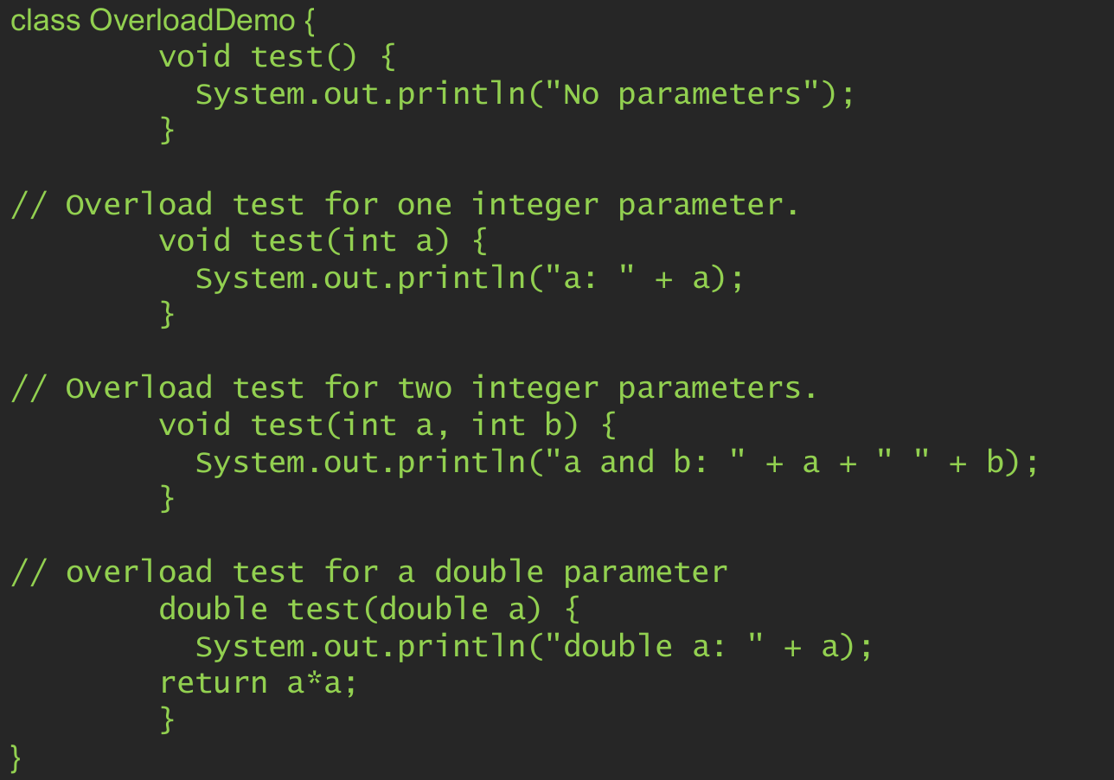
Method overloading -Example code

Slide 30
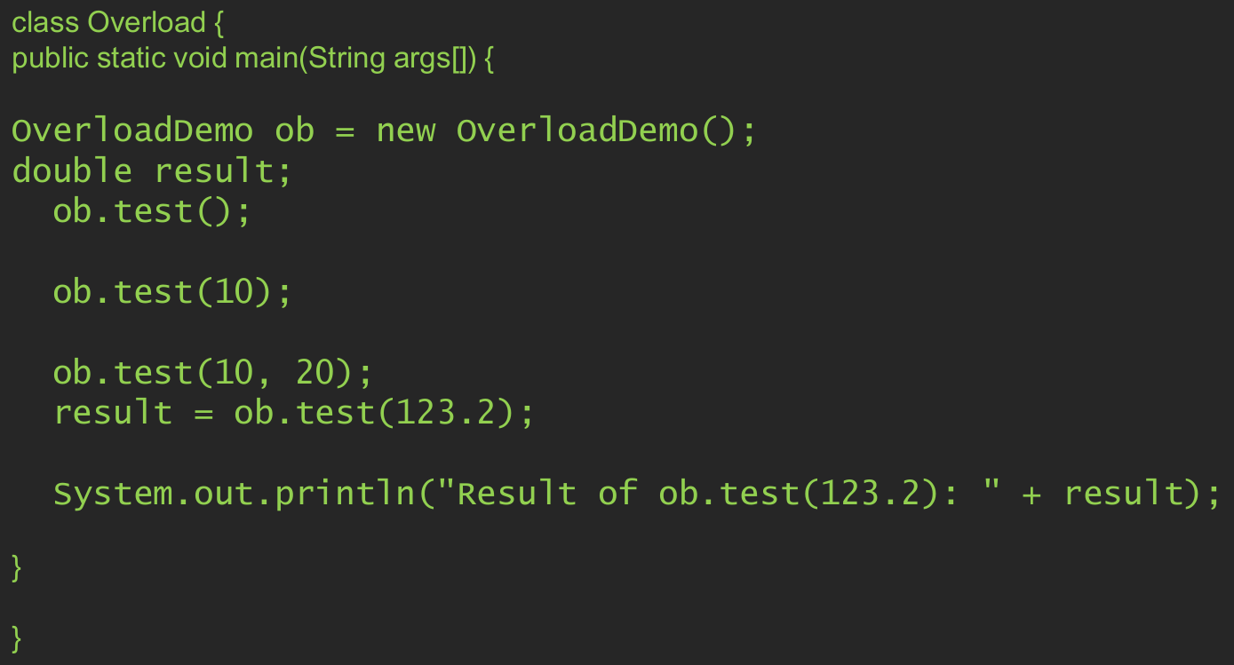
Method overloading -Calling overloaded methods

Slide 31
Constructor overloading
Constructors are methods that can be overloaded, just like any other method in a class.
When you want to generate objects of a class from different sets of initial defining data.

Slide 32
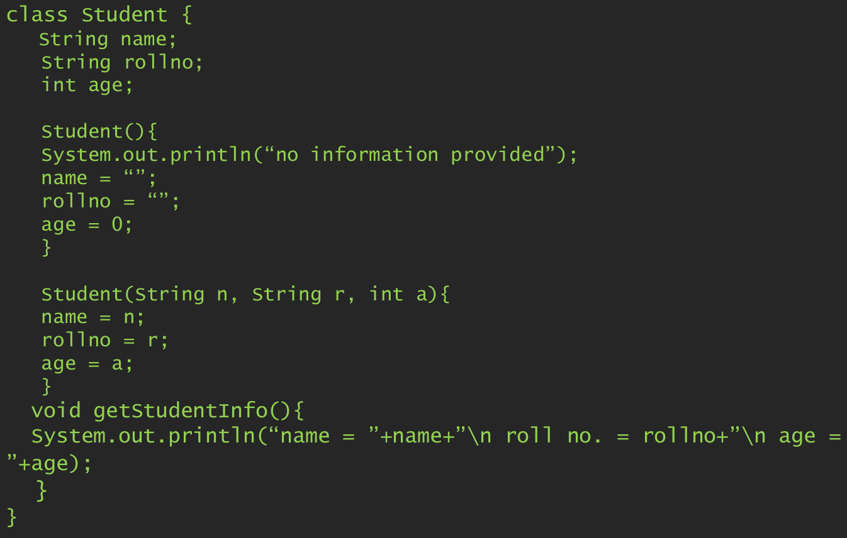
Constructor overloading -Example code

Slide 33
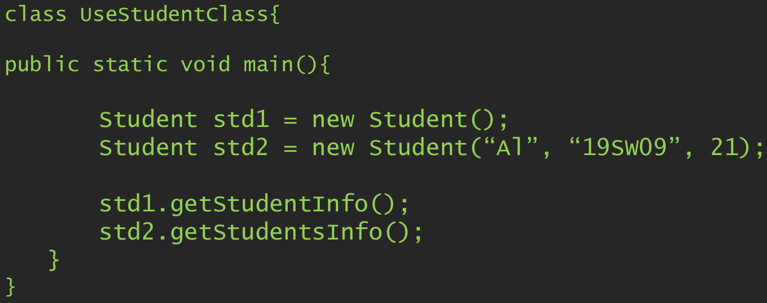
Constructor overloading -creating objects through overloaded constructors

Slide 34
Encapsulation & access specifiers
Java’s access specifiers are public, private, and protected.
Java also defines a default access level.
Encapsulation, you can control what parts of a program can access the members of a class.
By controlling access, you can prevent misuse.

Slide 35
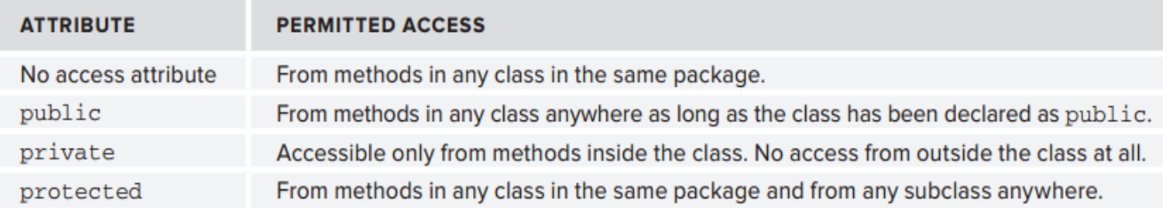
Encapsulation & access specifiers
Java provides the following access specifiers:

Slide 36
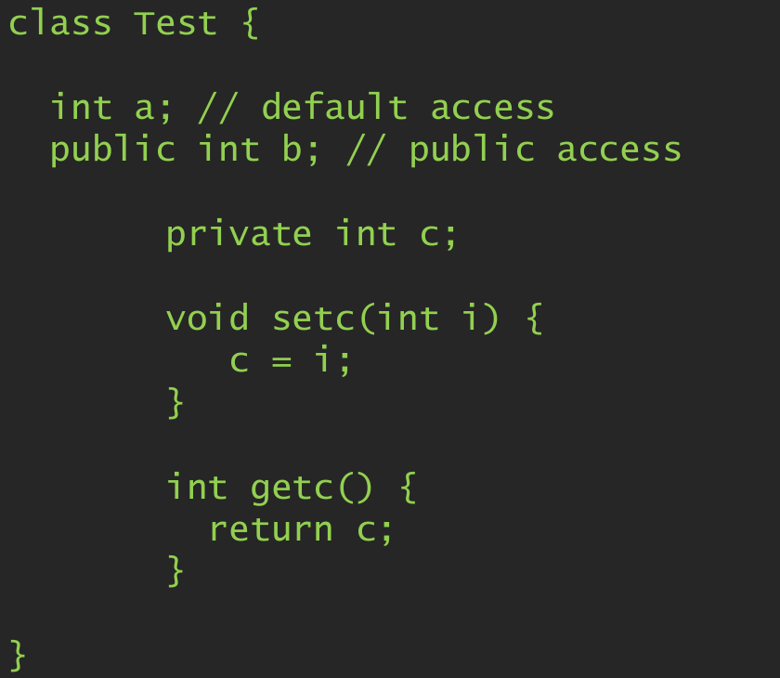
Encapsulation & access specifiers -example code

Slide 37
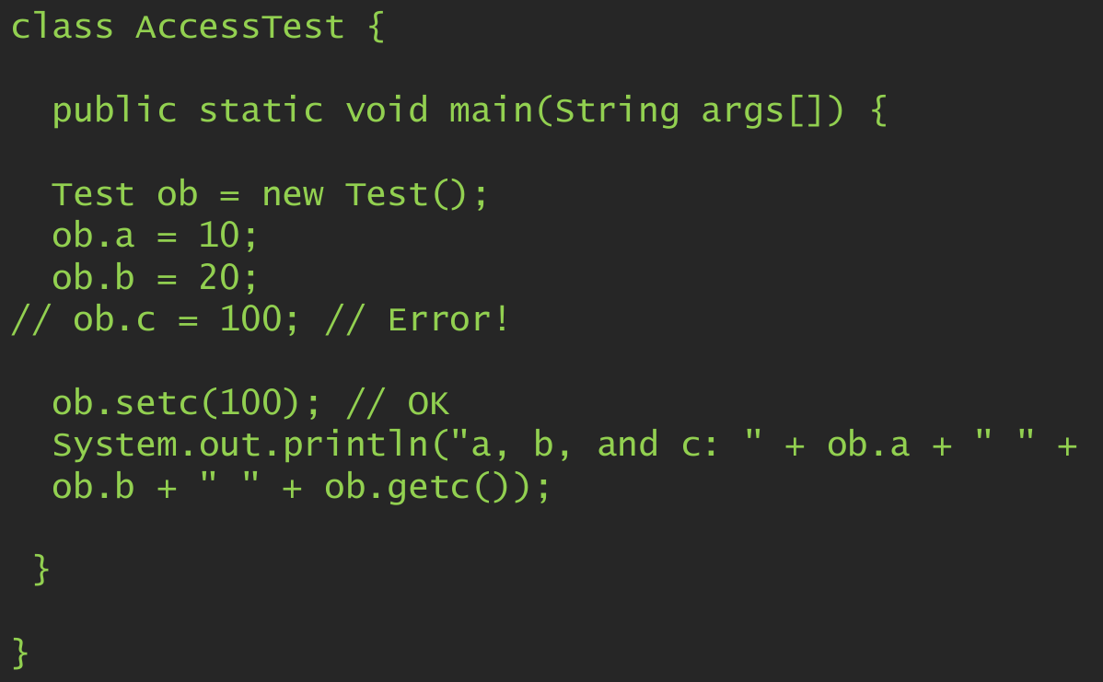
Encapsulation & access specifiers -example code contd.

Slide 38
Static keyword
A static class member can be accessed without creating an object.
You can declare both methods and variables to be static.
main() is a common example.
Methods declared as static have several restrictions:
They can only call other static methods.
They must only access static data.
They cannot refer to this or super in any way.

Slide 39
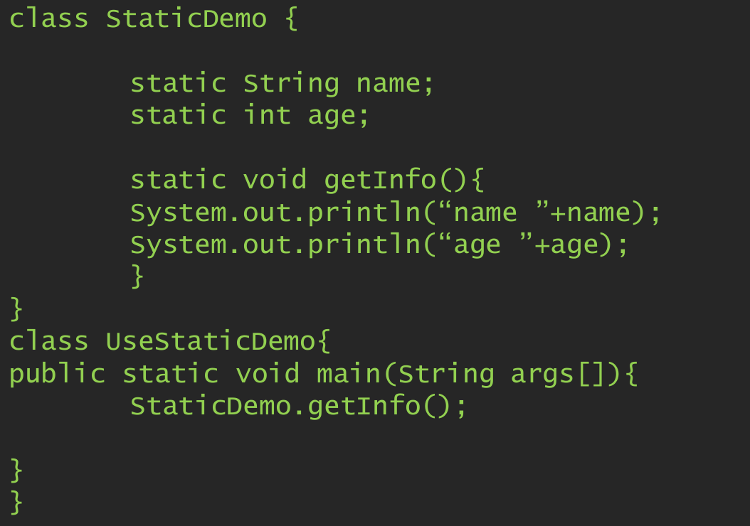
Static keyword -example code

Slide 40
Static block
Static blocks are also called Static initialization blocks.
A static initialization block is a normal block of code enclosed in braces, { }, and preceded by the static keyword.
static{
// whatever code is needed for initialization goes here
}

Slide 41
Introducing math class
The java.lang.Math class contains methods for performing basic numeric operations such as the elementary exponential, logarithm, square root, and trigonometric functions.
Access these functions without making the object as they are all declared static.
E.g. Math.method(arg)

Slide 42
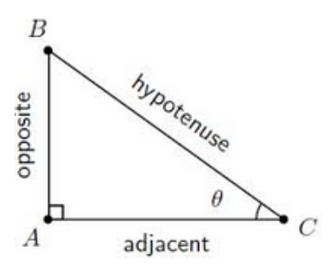
Code it now!
Consider a right-angle triangle like this one. Write a java class with three instance variables hypotenuse, perpendicular and base. Create two overloaded constructors for initializing these lengths including a default constructor that gives default values.
Create three functions,
getHyp(double , double) returns hyp after calculation,
getPerp(double, double) returns perp after calculation,
getBase(double, double) returns base after calculation.

Slide 43
Code it now!
Overload the functions in the previous slides:
getHyp(double length, double angle)
getBase(double length, double angle)
getPerp(double length, double angle)
Each function must return the side after taking length and angle

Slide 44
Final keyword
Doing so prevents its contents from being modified.
This means that you must initialize a final variable when it is declared.
It is a common coding convention to choose all uppercase identifiers for final variables
final double PI = 3.142;

Slide 45
Nested or inner class
You can put the definition of one class inside the definition of another class.
The inside class is called a nested class.
A top-level class is a class that contains a nested class but is not itself a nested class.
Syntax:
public class Outside {
// Nested class
public class Inside {
// Details of Inside class...
}
// More members of Outside class...
}

Slide 46
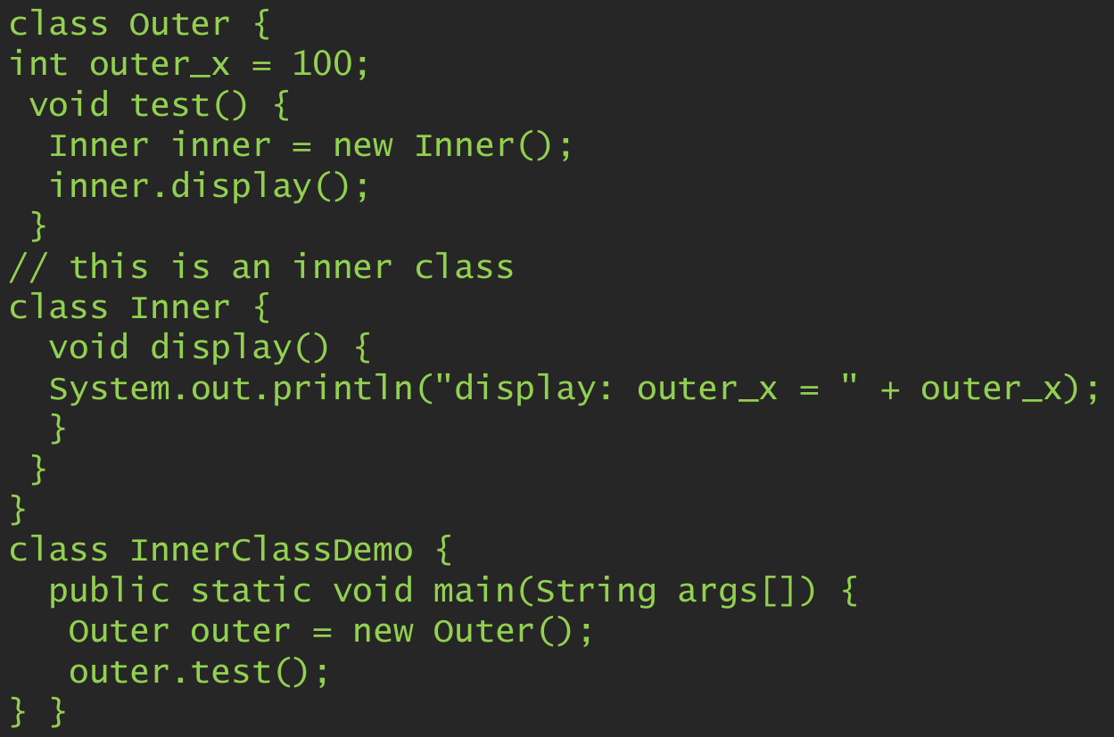
Nested or inner class -Example code

Slide 47
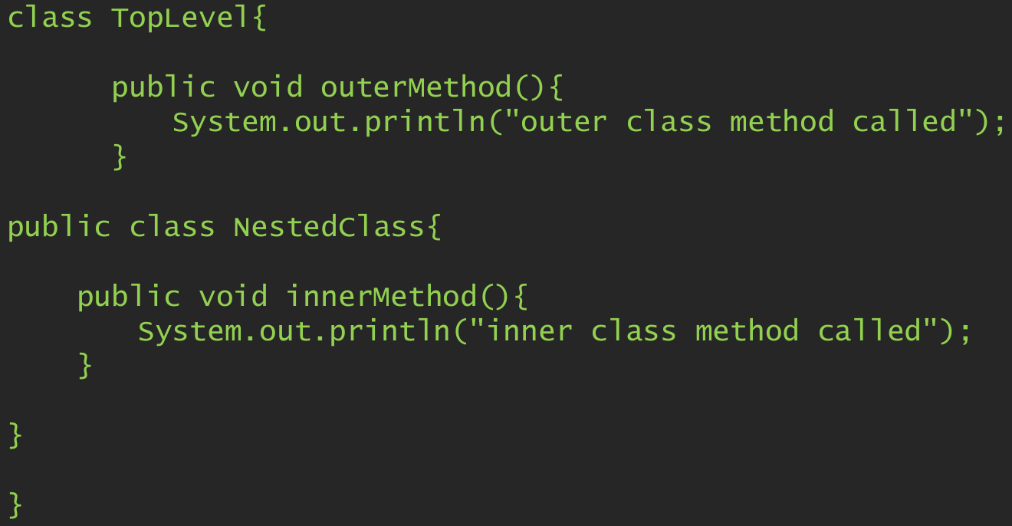
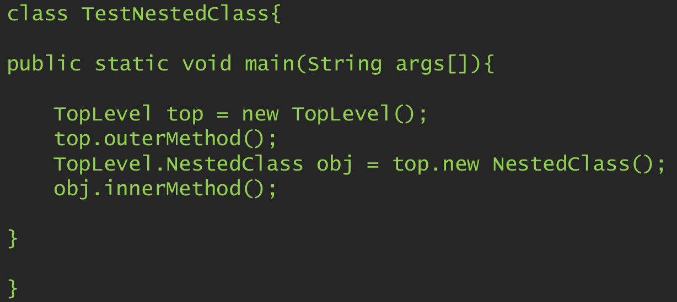
Nested or inner class -Example code 2

Slide 48
THANK YOU!

